Slide 1
Secure data hiding in image using steganography
CAPSTONE PROJECT
Presented By: DARSHAN B M
College Name & Department :SDM INSTITUTE OF TECHNOLOGY, UJIRE. ARTIFICIAL INTELLIGENCE & DATA SCIENCE(BRANCH)

Slide 2
OUTLINE
Problem Statement
Technology used
Wow factor
End users
Result
Conclusion
Git-hub Link
Future scope

Slide 3
Problem Statement
The project aims to develop a simple image-based encryption and decryption system that allows users to hide secret messages within JPEG images. Users can input a secret message and a passcode, which will be embedded into the pixel values of the specified image. The system will ensure that only authorized users with the correct passcode can retrieve the hidden message. This project serves as an educational tool to understand basic concepts in steganography and image processing while providing a practical application for secure communication.

Slide 4
Technology used
Libraries:
OpenCV: A powerful library for image processing that allows for reading, writing, and manipulating images.
OS: A standard Python library used for interacting with the operating system, such as opening files or executing system commands.
string: A built-in Python module provides various string constants and utility functions
Platforms:
Python: The programming language used to implement the encryption and decryption scripts.
Windows 10: The operating system on which the scripts can be executed
Integrated Development Learning Environment (IDLE): Any Python-compatible IDLE or text editor can be used to write and run the scripts

Slide 5
Wow factors
User -Friendly Interface: The command-line interface allows users to easily encrypt and decrypt messages without needing extensive technical knowledge.
Visual Representation of Data: The ability to visually represent hidden data within an image adds an artistic element.
Potential for Advanced Security Features: The project can be extended to incorporate more advanced security features, such as using cryptographic algorithms (e.g., AES or RSA).
Educational Value: This serves as an excellent educational tool for understanding fundamental concepts in steganography, image processing, and basic cryptography.

Slide 6
End users
Government Agencies
Military Agencies
Journalists
Businesses
Researchers
General Public

Slide 7
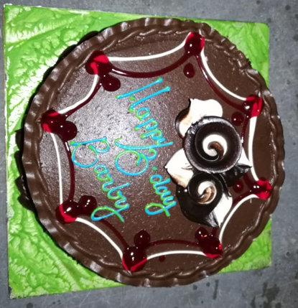
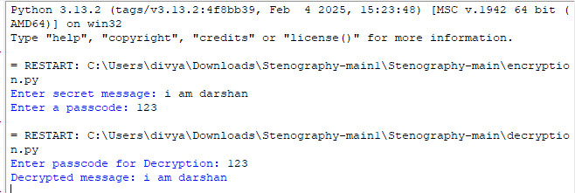
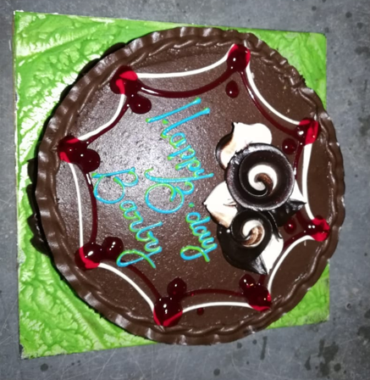
Results
My picture
Output
Encrypted image

Slide 8
Conclusion
The image encryption and decryption project effectively combines steganography to securely hide and retrieve messages within images. Utilizing Python's powerful libraries, it offers a user-friendly interface that makes encryption accessible to users of all skill levels. The project not only addresses the growing need for secure communication but also serves as an educational tool, providing insights into data security and cryptography. Future enhancements could include advanced encryption methods and a graphical user interface, further expanding its functionality and user engagement.

Slide 9
GitHub Link
https://github.com/Dars123-png/my_project1.git

Slide 10
Future scope(optional)
Integration with Artificial Intelligence: AI can be utilized to enhance encryption processes.
Applications in Emerging Technologies: The integration of image encryption in areas like blockchain technology for secure transactions.
Military and Forensic Applications: The need for secure communication in military operations and the protection of sensitive forensic data will drive the demand for advanced image encryption techniques

Slide 11
THANK YOU

